Slide 1


Introduction to Quantum Machine Learning
By
Mentor: Dr. Peter Nimbe
University of Energy and Natural Resources
Department of Computer Science and Informatics
Ghana

Slide 2
What is Quantum Machine Learning?
Quantum machine learning (QML) is an interdisciplinary field that integrates quantum physics concepts with machine learning to produce algorithms that employ quantum computer’s processing power to address specific sorts of issues more effectively than classical computers.
The quantum computer, a whole new class of computing system, increases the hardware available for machine learning through quantum machine learning.
Quantum theory, which is based on completely different physics, is the foundation for information processing using quantum computers.
The collaboration of machine learning, quantum computing, and intelligent optimization algorithms serves as the foundation for addressing the complexities of future communication systems and optimizing their performance.

Slide 3
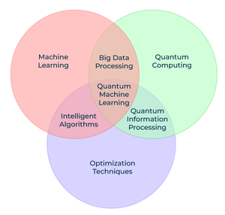
Quantum Machine Learning

Slide 4
Quantum Mechanics
It is generally acknowledged that every element demonstrates both particle and wave properties, as numerous scientists have repeatedly demonstrated throughout history.
Before being observed, a particle (such as an electron, photon, or other quantum entity) exists in every possible state in accordance with the laws of the quantum realm.
We refer to this phenomenon as superposition.
Schrodinger’s Cat experiment is one example of such a thought experiment.
Despite its seeming absurdity, Schrodinger’s Cat is a real phenomenon.
It’s crucial because, without the ability for quantum objects to exist in two states simultaneously, the computers you use would not be able to function.

Slide 5
Building Blocks of Quantum Computing
Our traditional computers use two-bit numbers 0 and 1. However, in the case of a Quantum computer, a bit can exist in a superposition of 0 and 1 with some probability of being 0 and some probability of being 1, which is referred to as Quantum bits or Qubits inspired by Quantum Mechanics laws.
Classical physics governs humans, and we eventually live in a world represented by classical physical science (for anything larger than a molecule).
As a result, the output must be classical – but measuring the values causes the qubit to lose its rationality and degrade into one of the potential states that a system can occupy.
Quantum entanglement is the result of qubits interacting in a way that makes it impossible to determine a bit’s current state on its own without also knowing about other bits.
To put it simply, each component depends on the other component as it stands at any given time. Large tech companies like Google, IBM, and NASA are already devoting significant financial resources to the development of quantum computing.

Slide 6
Machine learning with Quantum Computing
Machine Learning is all about complicated mathematical calculations with large dimensions of data.
Since a qubit can contain both 0 and 1 so we can say
So 1 qubit is 2 bits,2 qubit is 4 bits, 3 Qubit is 8 bits… and so on.
Wait are you not impressed?
Then let’s just imagine 300 Qubits which is 2^300 i.e. 2^270 GB.
We don’t even have that many atoms in the world(never underestimate the power of exponentials).
Taking advantage of this classical data is converted into the Quantum data with dimensions reduced exponentially.
Quantum data is any data source that occurs in a natural or artificial quantum system.
Heuristic machine learning techniques can create models that maximize the extraction of useful classical information from noisy entangled data.

Slide 7
Machine learning with Quantum Computing
The TensorFlow Quantum (TFQ) library provides primitives for developing models that disentangle and generalise correlations in quantum data, allowing for the improvement of existing quantum algorithms as well as the discovery of new quantum algorithms.
In addition, unlike classical computers, where a fixed input bit is sent to a logic gate module for some arithmetic operation and a corresponding fixed bit is obtained as output, quantum computers use quantum logic gates where the input is a superposition bit and the output is also an entangled superposition bit.
In this process, the same input qubit can be manipulated to the various required outputs with varying entanglement in the logic gates, allowing us to find patterns and relations in the data more quickly.
While performing the same task in a classical computer, and in some cases, supercomputers also can take very years to calculate because of limitations in the computation power.
And that’s what machine learning is all about finding hidden patterns in the data.

Slide 8
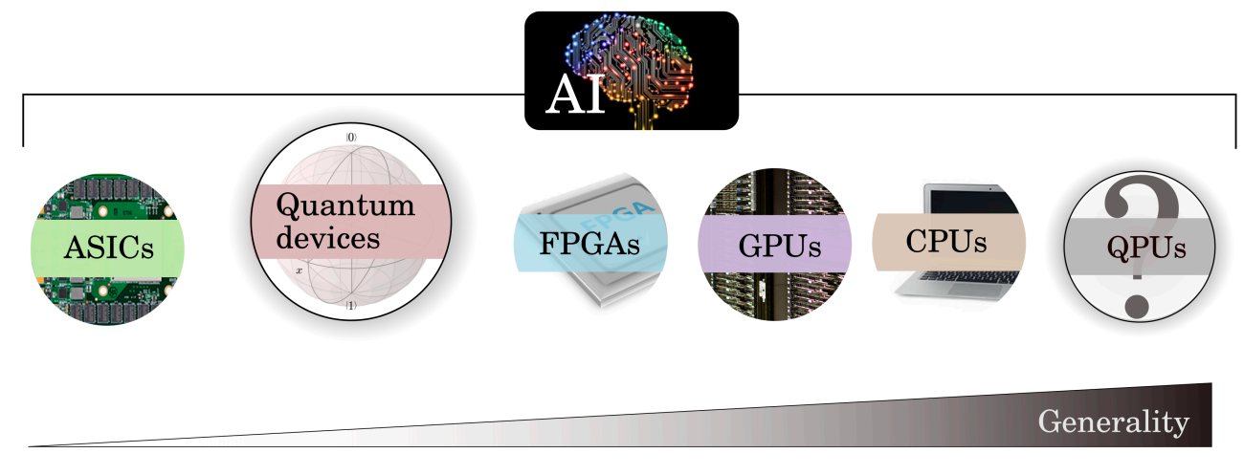
Why QML
Machine learning (ML) has proven to be super useful in everyday life
ML today already uses different processors: CPUs, GPUs, TPUs, etc.
Quantum computers (QPUs) could be used as special-purpose ML accelerators
May enable training of previously intractable models by leveraging the power of quantum mechanics

Slide 9
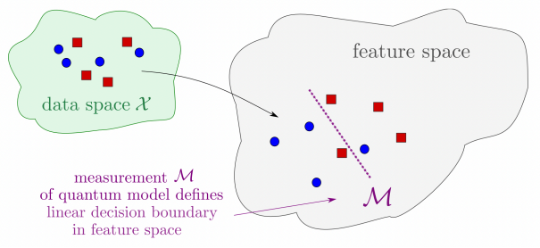
Why QML
Quantum computing could also lead to new machine learning models
Examples: Quantum kernel methods, Quantum neural networks (QNNs), Quanvolutional neural networks, Quantum Boltzmann machines, Quantum generative adversarial networks (qGANs)

Slide 10
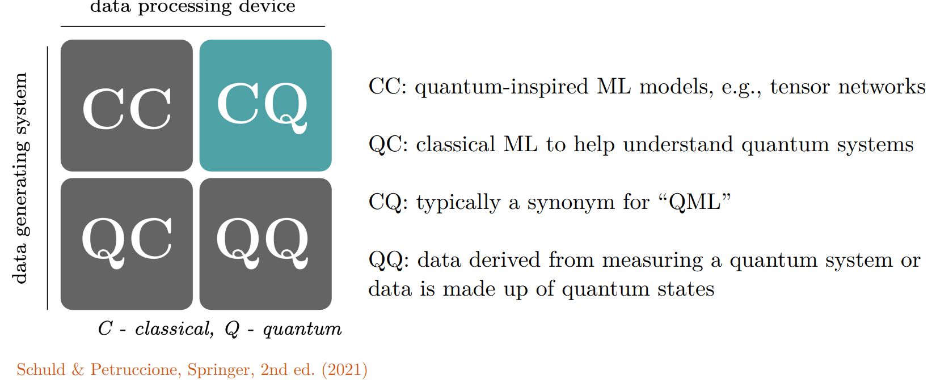
QML approaches

Slide 11
Key concepts of QML
Variational quantum circuits (VQCs)
Main QML method for noisy intermediate-scale quantum (NISQ) devices
Structure similar to other modern quantum algorithms: e.g. variational quantum eigensolver (VQE), quantum approximate optimization algorithm (QAOA)
General steps:
1. Preparation of a fixed initial state
2. Encode classical data into a quantum state (encoding/embedding layer)
3. Apply a parameterized model (processing layer)
4. Perform measurements to extract observables

Slide 12
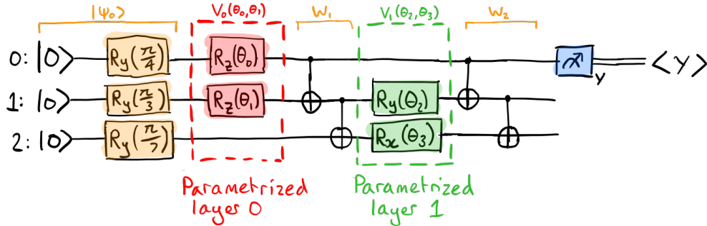
Variational quantum circuits (VQCs)

Slide 13
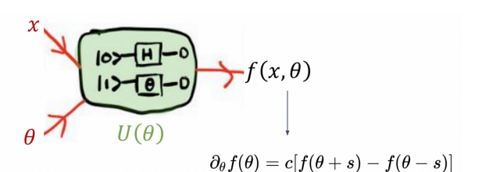
Key concepts of QML
Quantum circuit training
How to train variational quantum circuits like we train neural networks?
Most widely used method: gradient descent - SGD, Adam, natural gradient, etc; all of them require one important ingredient: the gradient of a circuit’s output with respect to its input parameters
Backpropagation: powers modern deep learning models
Pros: nice scaling properties w.r.t. the number of parameters
Cons: increased memory usage to store all intermediate values; can’t be used directly on quantum computers
Parameter-shift rule
Pros: allows us to compute the function and its gradient on the same quantum device; gives exact gradients
Cons: scales roughly linearly with the number of parameters

Slide 14
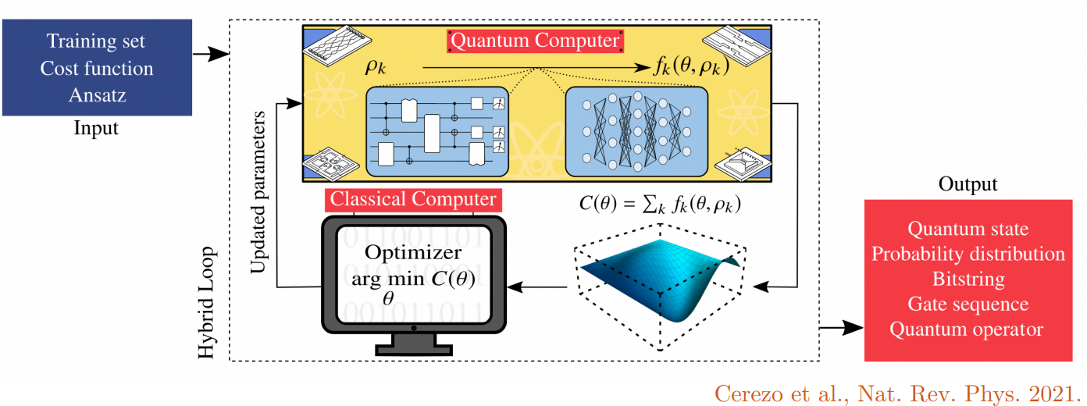
Key concepts of QML
Hybrid computation
Use quantum computers together with classical processors (CPUs, GPUs)
Classical optimization loop
Pre-/post-process quantum circuits outputs
Arbitrarily structured hybrid computations
Hybrid quantum-classical neural networks

Slide 15
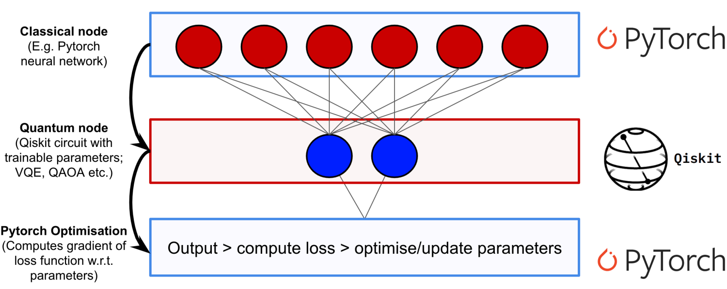
Hybrid NNs
Classical neural network with a quantum component

Slide 16
Applications of Quantum Computing imposed with Machine Learning
Several uses for quantum computing in conjunction with machine learning include;
One of the most intriguing and potent subfields of machine learning is deep learning, which necessitates extensive matrix and linear multiplication.
Massive matrix multiplication is necessary for neural networks, but loading the same onto a quantum logic gate is a non-trivial task that can be completed very quickly due to the quantum properties of the gate.
This allows the multiplication of an exponentially large matrix with a similarly large vector.
The design of pharmaceuticals and medical equipment, which is a laborious task even for supercomputers, can be impacted by quantum machine learning.
This is because quantum machine learning necessitates the computationally challenging description and computation of every quantum property of an atom in a molecule.
However, since a quantum computer uses the same properties, it performs better.

Slide 17
Applications of Quantum Computing imposed with Machine Learning
Small-scale quantum computing combined with strong classical computing in a hybrid form for extremely large datasets (e.g., topological analysis).
In order to prevent hackers from surreptitiously copying the key because of the uncertainty, quantum uncertainty can be combined with GANs for cybersecurity purposes to generate private keys for encrypting messages from one place to another.
It may sound crazy, but there is a chance that we will be able to teleport information without actually sending it across space and time.
This is possible because quantum particles have fluid identities that become entangled over time and space in such a way that altering one particle affects the other, ultimately forming a teleportation channel.

Slide 18
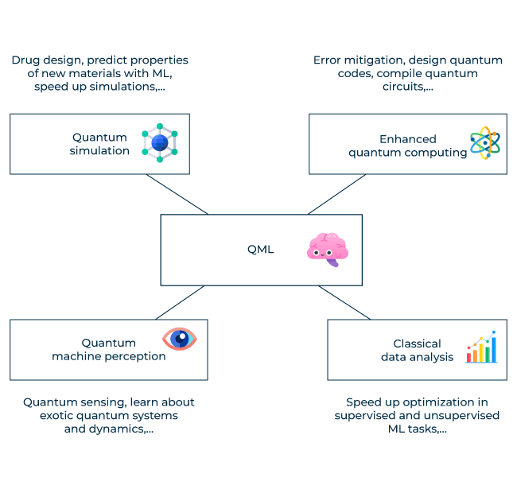
Applications of Quantum Computing imposed with Machine Learning

Slide 19
Applications of Quantum Computing imposed with Machine Learning
Quantum computers are a type of computer where the number of operations needed to reach a state is exponentially small, rather than where every operation will be faster.
Thus, the increase is in the overall number of operations rather than the speed at which they are performed.
They won’t be any faster for sending emails or watching YouTube videos, but rather for a specific kind of calculation where computational parallelism is seen.
In summary, while the aforementioned ideas may seem implausible, we cannot rely solely on common sense when navigating the quantum world.
Quantum computers are not more powerful versions of traditional computers, just as you cannot make a light bulb by increasing the power of candles.
It’s an entirely new technology based on quantum mechanics that will undoubtedly boast machine learning million times over.
Also, IBM provides access to the most advanced quantum computers for real-world work, so go ahead and try it out.

Slide 20
Uses of Quantum Machine Learning
Quantum data analysis: Big quantum datasets produced by quantum sensors or simulators can be analyzed using quantum machine learning. This might make it possible to analyze data more effectively and find patterns and insights more quickly.
Quantum chemistry: Drug development and materials science benefit greatly from the ability to model and anticipate molecular behavior and chemical reactions through the use of quantum machine learning.
Quantum optimization: Identifying the ideal configuration for a sizable system of interconnected components is one optimization problem that can be resolved using quantum machine learning. Supply chain management, scheduling, and logistics can all benefit from this.
Quantum anomaly detection: When a quantum computer is being hacked, for example, anomalies in the system can be found using quantum machine learning.
Quantum cryptography: The security of quantum cryptography systems can be increased by using quantum machine learning, for example, by identifying and blocking eavesdropping on quantum communication channels.

Slide 21
Issues in Quantum Machine Learning
Hardware limitations: In order to be used for machine learning applications in the real world, quantum computers still have a long way to go due to significant hardware limitations.
Noise and error correction: The accuracy and dependability of quantum machine learning models may be adversely affected by the inherent noise and error-proneness of quantum systems. One of the biggest challenges in the field is creating efficient error correction techniques.
Algorithm development: Considering quantum algorithms are fundamentally different from classical algorithms, developing effective and efficient quantum machine learning algorithms is a significant challenge.
Data preparation: Designed data preparation techniques are necessary for quantum machine learning, and they can be difficult and time-consuming.
Results interpretation: Since quantum machine learning models are based on states and processes that are fundamental to quantum mechanics and may be challenging to comprehend and visualize, they can be challenging to interpret.
Scalability: Given that the resources needed to carry out quantum computations grow exponentially with the size of the problem, scaling up quantum machine learning models to handle big datasets and complicated problems is extremely difficult.

Slide 22
Task for Today
Data Preprocessing of the Merchandize Trade Flow Dataset
Define the quantum device
Define the quantum cell function
Custom Keras Layer that wraps the quantum LSTM cell
Build the Keras model with quantum LSTM
Process each timestep with QuantumLSTMTimestepLayer
Concatenate timestep outputs along the time dimension
LayerNormalization for compatibility in graph mode
Define Dropout and Dense layer for final output
Define and compile the model
Train the model

